Slide 1

Energetic Soda
La Liga

Slide 2

INTRODUCTION
The company interested in investing in a football team in Spain.
Our marketing team has contacted every team playing in "La Liga" (the Spanish league) and after some studies,
we know the price for every sponsorship and also we know the value, to our brand, for every goal scored by a team.
Our CEO is requesting an analysis to determine which team is the better for us

Slide 3
CONSIDERATIONS
Budget
Not lose category
European cup
Max. $400,000
The team will be consistent in playing in La Liga, that means, that is not propense to lose the category
(Desirable)
If we can get a team which plays a European cup would be great for our company

Slide 4
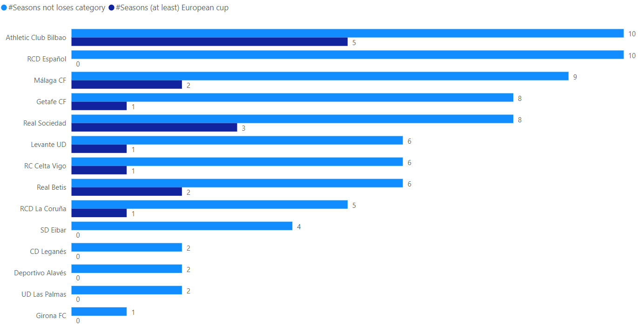
ANALYSIS
There are 14 teams that the company can purchase within its budget
Out of the 14 teams, only 2 teams meet the consideration of not losing their category in La Liga
Ideally, Team Athletic Club Bilbao meets the requirement of participating in at least the European Cup.

Slide 5
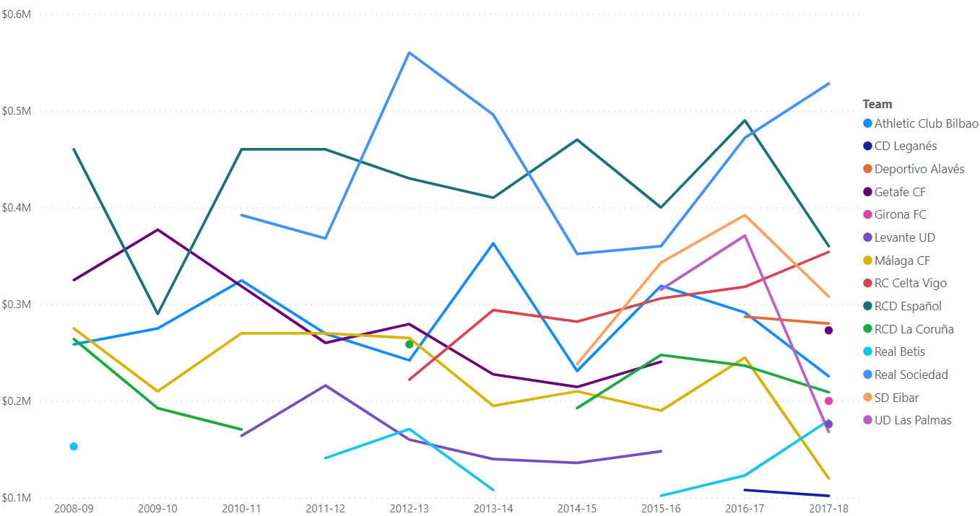
ANALYSIS
The chart displays the profitability (based on goals) of each team for each season
As we can see, Athletic Club Bilbao and RCD Español are the ones that stand out among all the trends because they have better historical profitability

Slide 6
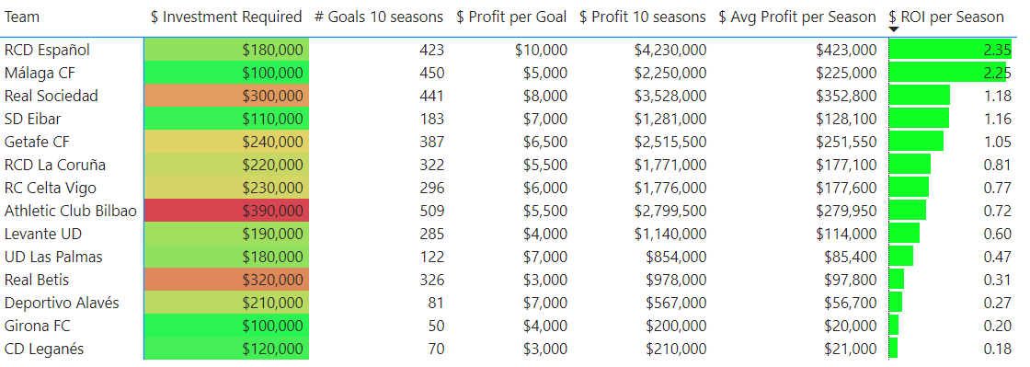
ANALYSIS
Comparing RCD Español and Athletic Club Bilbao:
Athletic Club Bilbao costs a little over twice as much as RCD Español
Athletic Club Bilbao has scored more goals than RCD Español
However, the profit per goal is higher in RCD Español than Athletic Club Bilbao. Therefore, RCD Español has a higher profit overall
RCD Español has a higher value in terms of the ROI indicator, which means that for every $1 invested, a return of $2.35 is obtained.
ROI: Return of investment

Slide 7
TEAM SELECTED
RCD ESPAÑOL
RCD Español is chosen because it's within the budget and has remained in its category for the past 10 seasons. Furthermore, despite not having the maximum number of goals, it has the highest profitability and ROI

